Slide 1



IAG Presentation
Tommy Tran Duc Thang
Notes:
https://pixabay.com/es/photos/negocio-hombre-empresario-1042706/
https://pixabay.com/es/photos/modelo-empresario-corporativo-2911332/
https://pixabay.com/es/photos/gente-mujer-llamada-tienda-caf%c3%a9-2588594/
https://pixabay.com/es/photos/hombre-de-negocios-hombre-retrato-805769/
https://pixabay.com/es/photos/mujer-trabajo-oficina-pizarron-4702060/
https://pixabay.com/es/photos/empresario-hombre-corredor-de-bolsa-481113/
https://www.pexels.com/es-es/foto/hombre-de-chaqueta-de-traje-negro-con-ordenador-portatil-plateado-3777564/

Slide 2
01
02
Back Stage
Understanding
Who am I
03
04
My Proposal
QA
Notes:
https://pixabay.com/es/photos/negocio-hombre-empresario-1042706/
https://pixabay.com/es/photos/modelo-empresario-corporativo-2911332/
https://pixabay.com/es/photos/gente-mujer-llamada-tienda-caf%c3%a9-2588594/
https://pixabay.com/es/photos/hombre-de-negocios-hombre-retrato-805769/
https://pixabay.com/es/photos/mujer-trabajo-oficina-pizarron-4702060/
https://pixabay.com/es/photos/empresario-hombre-corredor-de-bolsa-481113/
https://www.pexels.com/es-es/foto/hombre-de-chaqueta-de-traje-negro-con-ordenador-portatil-plateado-3777564/

Slide 3
01
Who am I
Notes:
https://pixabay.com/es/photos/negocio-hombre-empresario-1042706/
https://pixabay.com/es/photos/modelo-empresario-corporativo-2911332/
https://pixabay.com/es/photos/gente-mujer-llamada-tienda-caf%c3%a9-2588594/
https://pixabay.com/es/photos/hombre-de-negocios-hombre-retrato-805769/
https://pixabay.com/es/photos/mujer-trabajo-oficina-pizarron-4702060/
https://pixabay.com/es/photos/empresario-hombre-corredor-de-bolsa-481113/
https://www.pexels.com/es-es/foto/hombre-de-chaqueta-de-traje-negro-con-ordenador-portatil-plateado-3777564/

Slide 4

Tommy Tran Duc Thang
I’m a senior DevOps and Platform engineer with proficient skills in designing and implementing the AWS Landing Zone infrastructure platform that is easy to use and scale for the Dev team. My career direction is to be a T-shaped engineer.
5+ years of experience as a DevOps/Platform Engineer
Team leader of the Platform team
Have deep knowledge in AWS, K8s, Observability
Proficient in IaC especially Terraform
Based in Computer Science major
Notes:
https://pixabay.com/es/photos/negocio-hombre-empresario-1042706/
https://pixabay.com/es/photos/modelo-empresario-corporativo-2911332/
https://pixabay.com/es/photos/gente-mujer-llamada-tienda-caf%c3%a9-2588594/
https://pixabay.com/es/photos/hombre-de-negocios-hombre-retrato-805769/
https://pixabay.com/es/photos/mujer-trabajo-oficina-pizarron-4702060/
https://pixabay.com/es/photos/empresario-hombre-corredor-de-bolsa-481113/
https://www.pexels.com/es-es/foto/hombre-de-chaqueta-de-traje-negro-con-ordenador-portatil-plateado-3777564/

Slide 5
Tommy Tran Duc Thang
Certifications (Just to prove I’m not bluffing :D):
Engineer’s Degree in Computer Science – HUST(Hanoi University of Science and Technology)
AWS Solution Architect Associate – SAA
AWS Developer Associate – DVA
Certified Kubernetes Administrator - CKA
Notes:
https://pixabay.com/es/photos/negocio-hombre-empresario-1042706/
https://pixabay.com/es/photos/modelo-empresario-corporativo-2911332/
https://pixabay.com/es/photos/gente-mujer-llamada-tienda-caf%c3%a9-2588594/
https://pixabay.com/es/photos/hombre-de-negocios-hombre-retrato-805769/
https://pixabay.com/es/photos/mujer-trabajo-oficina-pizarron-4702060/
https://pixabay.com/es/photos/empresario-hombre-corredor-de-bolsa-481113/
https://www.pexels.com/es-es/foto/hombre-de-chaqueta-de-traje-negro-con-ordenador-portatil-plateado-3777564/

Slide 6
Tommy Tran Duc Thang
Tech Stack:
Cloud: AWS (Proficient and having deep understanding).
Containerization platform: ECS, K8s (EKS).
CI/CD: Jenkins, AWS CodePipeline, Spacelift.
IaC: Terraform, CloudFormation.
Observability: OpenTelemetry, Grafana stack (Grafana, Loki, Tempo, Mimir), Jaeger, ELK, DataDog, NewRelic, Prometheus, Fluentbit, Fluentd.
Programming Languages: Bash, Go, JS, TS.
IDE: NeoVim enthusiast, VsCode
Other dev skills: Flutter – Dart (Mobile development), Springboot – Java (Backend development, React – JS, TS (Frontend Development).
Notes:
https://pixabay.com/es/photos/negocio-hombre-empresario-1042706/
https://pixabay.com/es/photos/modelo-empresario-corporativo-2911332/
https://pixabay.com/es/photos/gente-mujer-llamada-tienda-caf%c3%a9-2588594/
https://pixabay.com/es/photos/hombre-de-negocios-hombre-retrato-805769/
https://pixabay.com/es/photos/mujer-trabajo-oficina-pizarron-4702060/
https://pixabay.com/es/photos/empresario-hombre-corredor-de-bolsa-481113/
https://www.pexels.com/es-es/foto/hombre-de-chaqueta-de-traje-negro-con-ordenador-portatil-plateado-3777564/

Slide 7
02
Back Stage Understanding
Notes:
https://pixabay.com/es/photos/negocio-hombre-empresario-1042706/
https://pixabay.com/es/photos/modelo-empresario-corporativo-2911332/
https://pixabay.com/es/photos/gente-mujer-llamada-tienda-caf%c3%a9-2588594/
https://pixabay.com/es/photos/hombre-de-negocios-hombre-retrato-805769/
https://pixabay.com/es/photos/mujer-trabajo-oficina-pizarron-4702060/
https://pixabay.com/es/photos/empresario-hombre-corredor-de-bolsa-481113/
https://www.pexels.com/es-es/foto/hombre-de-chaqueta-de-traje-negro-con-ordenador-portatil-plateado-3777564/

Slide 8
What is Backstage
Internal Developer Portal (IDP)
Centralize software catalog
Solve the problem of system/development fragmentation
Can be used with the Golden Path ideology to educate newcomers to understand the platform and speed up the development process.
Backstage is just a framework running on top of React and uses TS. Which acts like a hub to add all of the required functionality in the form of plugins. You can use available plugins or create your own.
Notes:
https://pixabay.com/es/photos/negocio-hombre-empresario-1042706/
https://pixabay.com/es/photos/modelo-empresario-corporativo-2911332/
https://pixabay.com/es/photos/gente-mujer-llamada-tienda-caf%c3%a9-2588594/
https://pixabay.com/es/photos/hombre-de-negocios-hombre-retrato-805769/
https://pixabay.com/es/photos/mujer-trabajo-oficina-pizarron-4702060/
https://pixabay.com/es/photos/empresario-hombre-corredor-de-bolsa-481113/
https://www.pexels.com/es-es/foto/hombre-de-chaqueta-de-traje-negro-con-ordenador-portatil-plateado-3777564/

Slide 9
What is Backstage Capable of?
Unified Platform: Backstage provides a unified platform for developers to manage their software projects, dependencies, and services in one place.
Service Catalog: It includes a service catalog that allows developers to discover, understand, and use various services and components within an organization.
Collaboration: Backstage supports collaboration by providing tools for teams to communicate, share knowledge, and work together on projects.
Plugin Ecosystem: It has a plugin architecture, allowing developers to extend its functionality by adding plugins for different tools and services.
Developer Productivity: Backstage aims to improve developer productivity by streamlining workflows, reducing friction in the development process, and providing a consistent interface for various tools.
Infrastructure Monitoring: It may include features for monitoring the infrastructure and health of services, helping teams identify and address issues more effectively.
Customization: Backstage is designed to be customizable, allowing organizations to tailor it to their specific needs and integrate it with their existing tools and processes.
Notes:
https://pixabay.com/es/photos/negocio-hombre-empresario-1042706/
https://pixabay.com/es/photos/modelo-empresario-corporativo-2911332/
https://pixabay.com/es/photos/gente-mujer-llamada-tienda-caf%c3%a9-2588594/
https://pixabay.com/es/photos/hombre-de-negocios-hombre-retrato-805769/
https://pixabay.com/es/photos/mujer-trabajo-oficina-pizarron-4702060/
https://pixabay.com/es/photos/empresario-hombre-corredor-de-bolsa-481113/
https://www.pexels.com/es-es/foto/hombre-de-chaqueta-de-traje-negro-con-ordenador-portatil-plateado-3777564/

Slide 10
What is Golden Path
A way of work
Is the ‘opinionated and supported’ path to ‘build something’
Has a step-by-step tutorial that walks you through this opinionated and supported path (Techdocs Backstage plugin).
Put this simply as a way for the developer to on-board their service to the system which will align with the supported tooling such as observability, CI/CD and they don’t have to do it from the beginning. Which create a standard in the ecosystem and reduce the time for a service to go live.
Notes:
https://pixabay.com/es/photos/negocio-hombre-empresario-1042706/
https://pixabay.com/es/photos/modelo-empresario-corporativo-2911332/
https://pixabay.com/es/photos/gente-mujer-llamada-tienda-caf%c3%a9-2588594/
https://pixabay.com/es/photos/hombre-de-negocios-hombre-retrato-805769/
https://pixabay.com/es/photos/mujer-trabajo-oficina-pizarron-4702060/
https://pixabay.com/es/photos/empresario-hombre-corredor-de-bolsa-481113/
https://www.pexels.com/es-es/foto/hombre-de-chaqueta-de-traje-negro-con-ordenador-portatil-plateado-3777564/

Slide 11
03
My Proposal
Notes:
https://pixabay.com/es/photos/negocio-hombre-empresario-1042706/
https://pixabay.com/es/photos/modelo-empresario-corporativo-2911332/
https://pixabay.com/es/photos/gente-mujer-llamada-tienda-caf%c3%a9-2588594/
https://pixabay.com/es/photos/hombre-de-negocios-hombre-retrato-805769/
https://pixabay.com/es/photos/mujer-trabajo-oficina-pizarron-4702060/
https://pixabay.com/es/photos/empresario-hombre-corredor-de-bolsa-481113/
https://www.pexels.com/es-es/foto/hombre-de-chaqueta-de-traje-negro-con-ordenador-portatil-plateado-3777564/

Slide 12
Backstage is great. But
Backstage:
Great for scaffolding application templates, managing K8s, Observability, and documentation.
But has minimal, limited support for creating infrastructure so how do we manage resource creation to follow Golden Path ideology?
To my experience developing platforms:
The most problematic is DevOps/Platform engineers will have to develop the platform quickly while allowing Dev-creating resources to start developing in parallel.
Dev doesn’t know how to create resources correctly. So DevOps has to do it, with a large project, this puts a lot of stress on the DevOps/Platform team and slow down the development.
Notes:
https://pixabay.com/es/photos/negocio-hombre-empresario-1042706/
https://pixabay.com/es/photos/modelo-empresario-corporativo-2911332/
https://pixabay.com/es/photos/gente-mujer-llamada-tienda-caf%c3%a9-2588594/
https://pixabay.com/es/photos/hombre-de-negocios-hombre-retrato-805769/
https://pixabay.com/es/photos/mujer-trabajo-oficina-pizarron-4702060/
https://pixabay.com/es/photos/empresario-hombre-corredor-de-bolsa-481113/
https://www.pexels.com/es-es/foto/hombre-de-chaqueta-de-traje-negro-con-ordenador-portatil-plateado-3777564/

Slide 13
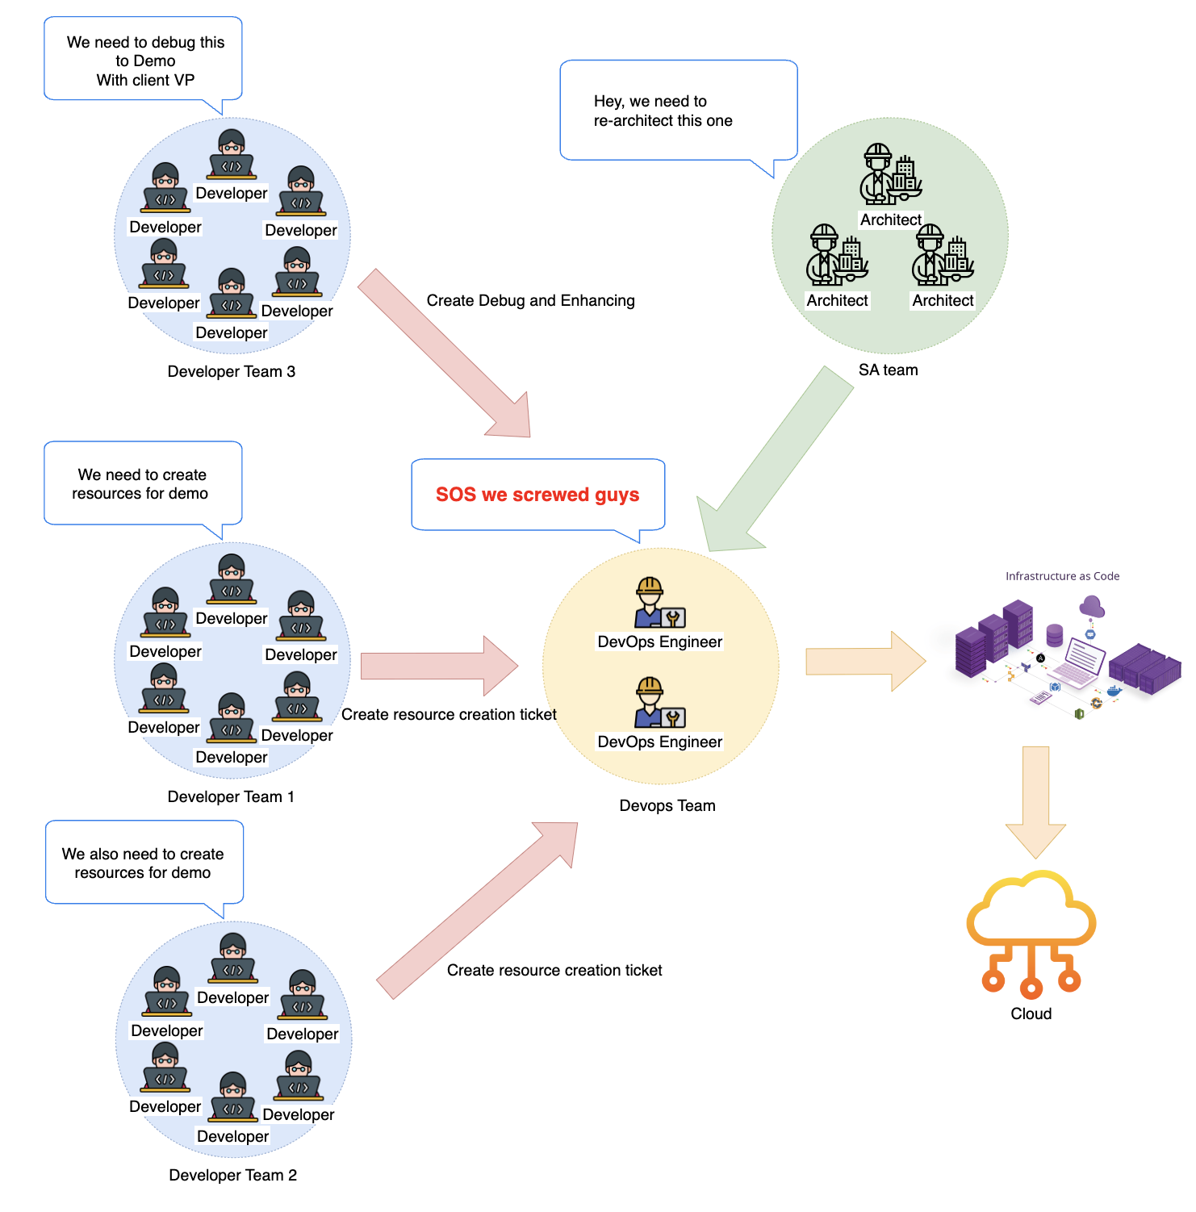
Backstage is great. But
A lot of stress is put on the DevOps/Platform team
demonstration
Notes:
https://pixabay.com/es/photos/negocio-hombre-empresario-1042706/
https://pixabay.com/es/photos/modelo-empresario-corporativo-2911332/
https://pixabay.com/es/photos/gente-mujer-llamada-tienda-caf%c3%a9-2588594/
https://pixabay.com/es/photos/hombre-de-negocios-hombre-retrato-805769/
https://pixabay.com/es/photos/mujer-trabajo-oficina-pizarron-4702060/
https://pixabay.com/es/photos/empresario-hombre-corredor-de-bolsa-481113/
https://www.pexels.com/es-es/foto/hombre-de-chaqueta-de-traje-negro-con-ordenador-portatil-plateado-3777564/

Slide 14
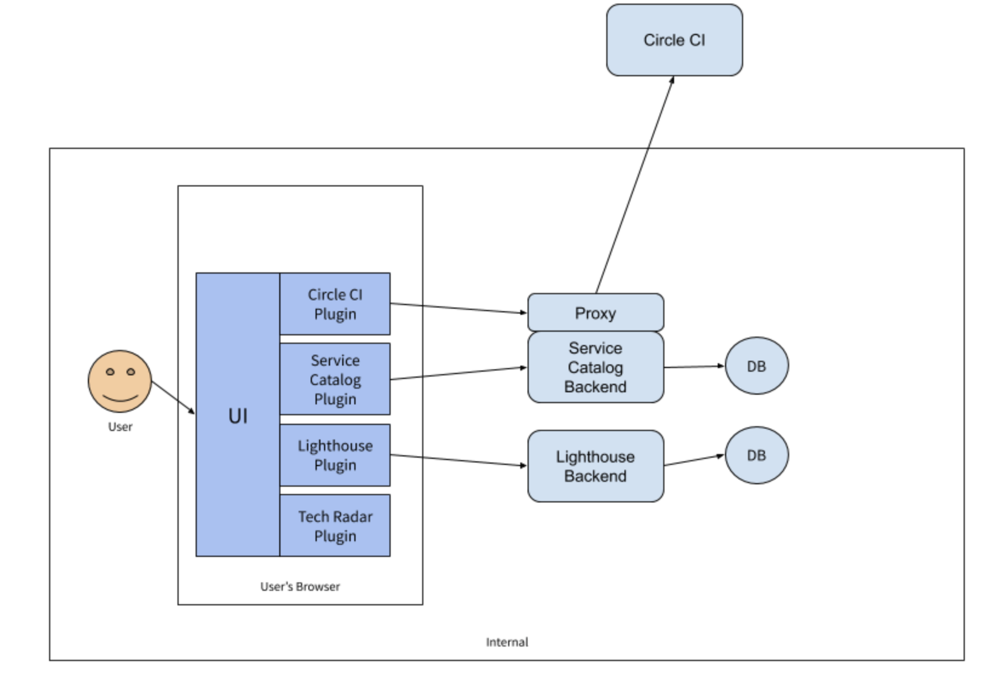
Backstage Infra Self-Service Plugin
This is the Backstage’s architecture, which is formed by the plugin ecosystem. Everything in Backstage is a plugin.
=> I created a plugin for Dev to create the infrastructure that follows the Golden Path ideology.
Notes:
https://pixabay.com/es/photos/negocio-hombre-empresario-1042706/
https://pixabay.com/es/photos/modelo-empresario-corporativo-2911332/
https://pixabay.com/es/photos/gente-mujer-llamada-tienda-caf%c3%a9-2588594/
https://pixabay.com/es/photos/hombre-de-negocios-hombre-retrato-805769/
https://pixabay.com/es/photos/mujer-trabajo-oficina-pizarron-4702060/
https://pixabay.com/es/photos/empresario-hombre-corredor-de-bolsa-481113/
https://www.pexels.com/es-es/foto/hombre-de-chaqueta-de-traje-negro-con-ordenador-portatil-plateado-3777564/

Slide 15
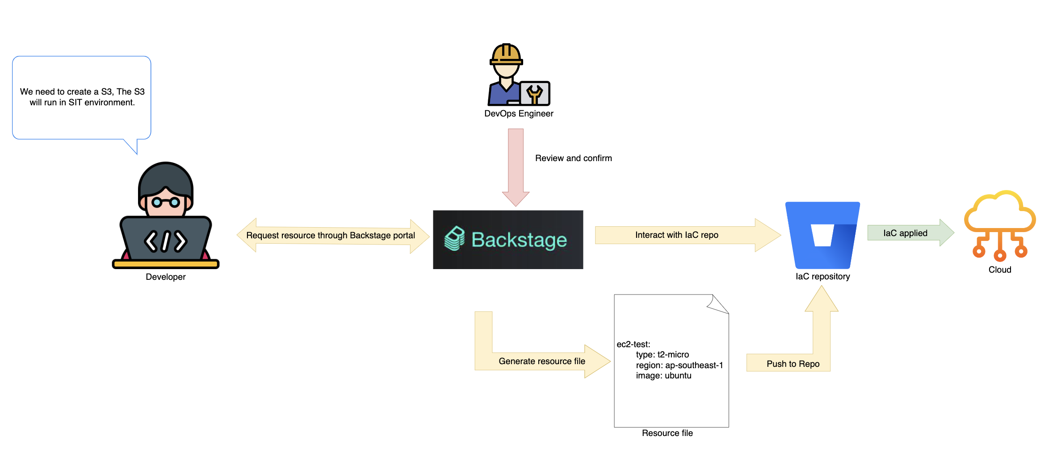
Backstage Infra Self-Service Plugin
Workflow design
Notes:
https://pixabay.com/es/photos/negocio-hombre-empresario-1042706/
https://pixabay.com/es/photos/modelo-empresario-corporativo-2911332/
https://pixabay.com/es/photos/gente-mujer-llamada-tienda-caf%c3%a9-2588594/
https://pixabay.com/es/photos/hombre-de-negocios-hombre-retrato-805769/
https://pixabay.com/es/photos/mujer-trabajo-oficina-pizarron-4702060/
https://pixabay.com/es/photos/empresario-hombre-corredor-de-bolsa-481113/
https://www.pexels.com/es-es/foto/hombre-de-chaqueta-de-traje-negro-con-ordenador-portatil-plateado-3777564/

Slide 16
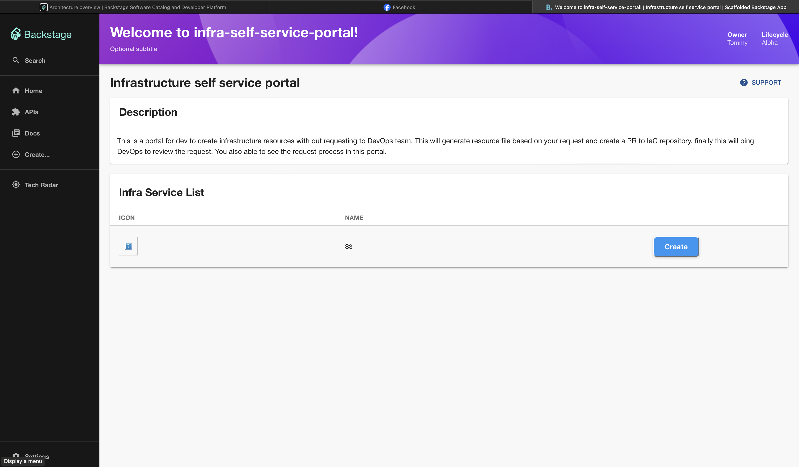
Backstage Infra Self-Service Plugin
Frontend plugin for infra selfservice portal
Notes:
https://pixabay.com/es/photos/negocio-hombre-empresario-1042706/
https://pixabay.com/es/photos/modelo-empresario-corporativo-2911332/
https://pixabay.com/es/photos/gente-mujer-llamada-tienda-caf%c3%a9-2588594/
https://pixabay.com/es/photos/hombre-de-negocios-hombre-retrato-805769/
https://pixabay.com/es/photos/mujer-trabajo-oficina-pizarron-4702060/
https://pixabay.com/es/photos/empresario-hombre-corredor-de-bolsa-481113/
https://www.pexels.com/es-es/foto/hombre-de-chaqueta-de-traje-negro-con-ordenador-portatil-plateado-3777564/

Slide 17
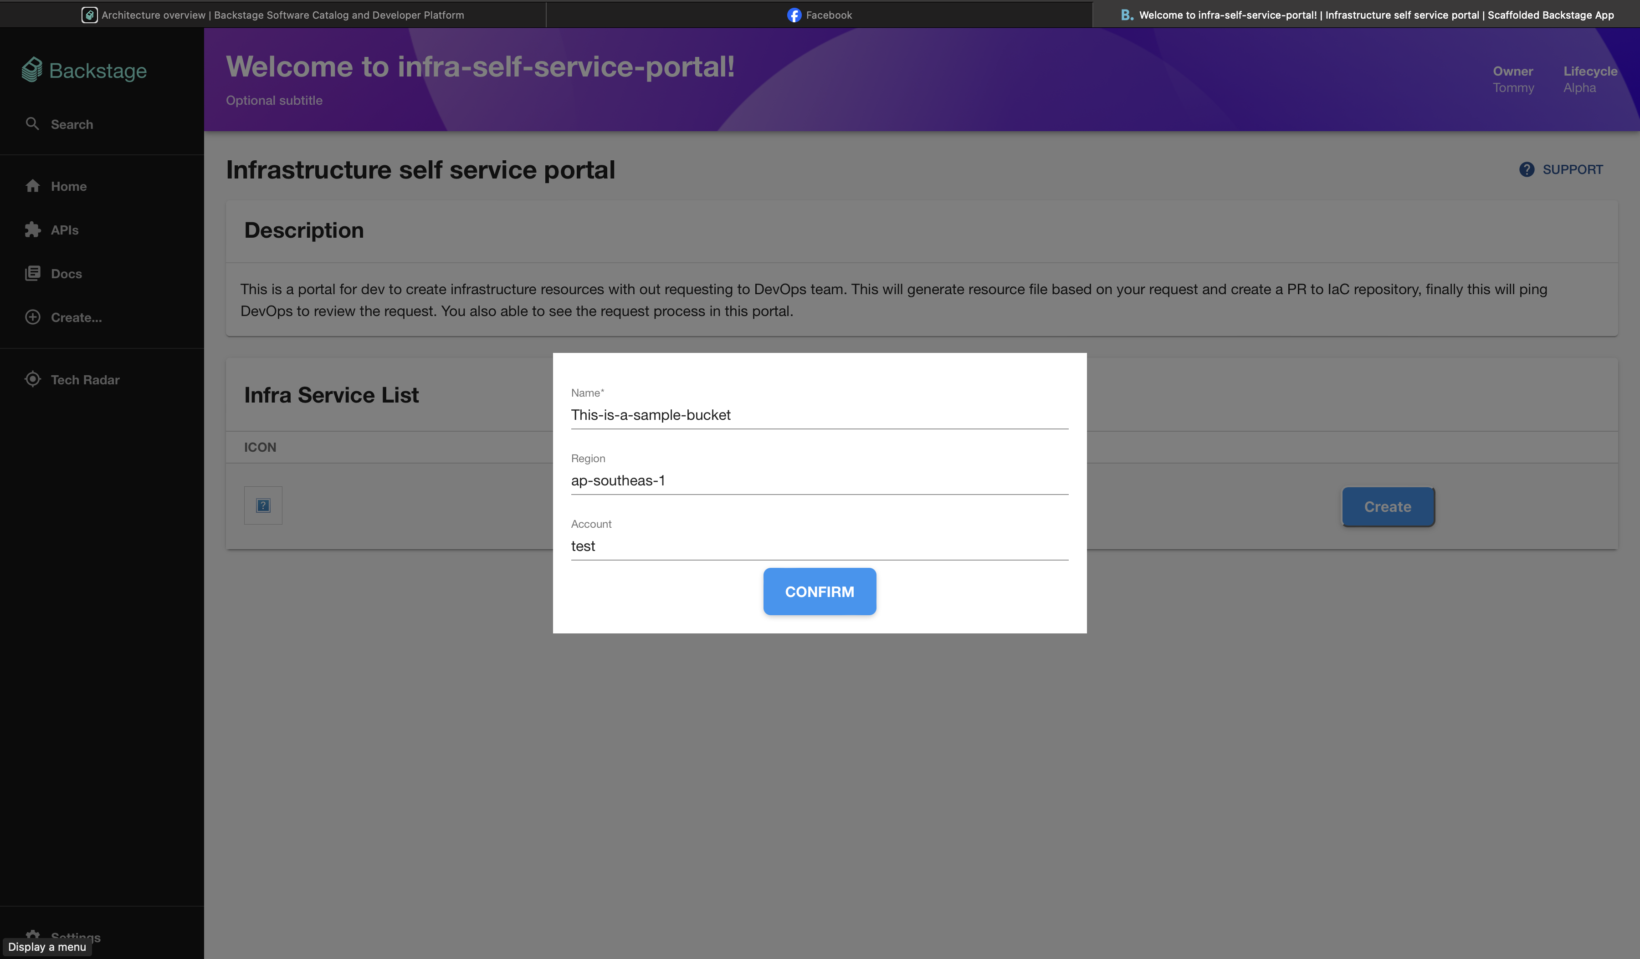
Backstage Infra Self-Service Plugin
S3 creation example
Only allow certain
Configuration to
Choose from
Notes:
https://pixabay.com/es/photos/negocio-hombre-empresario-1042706/
https://pixabay.com/es/photos/modelo-empresario-corporativo-2911332/
https://pixabay.com/es/photos/gente-mujer-llamada-tienda-caf%c3%a9-2588594/
https://pixabay.com/es/photos/hombre-de-negocios-hombre-retrato-805769/
https://pixabay.com/es/photos/mujer-trabajo-oficina-pizarron-4702060/
https://pixabay.com/es/photos/empresario-hombre-corredor-de-bolsa-481113/
https://www.pexels.com/es-es/foto/hombre-de-chaqueta-de-traje-negro-con-ordenador-portatil-plateado-3777564/

Slide 18
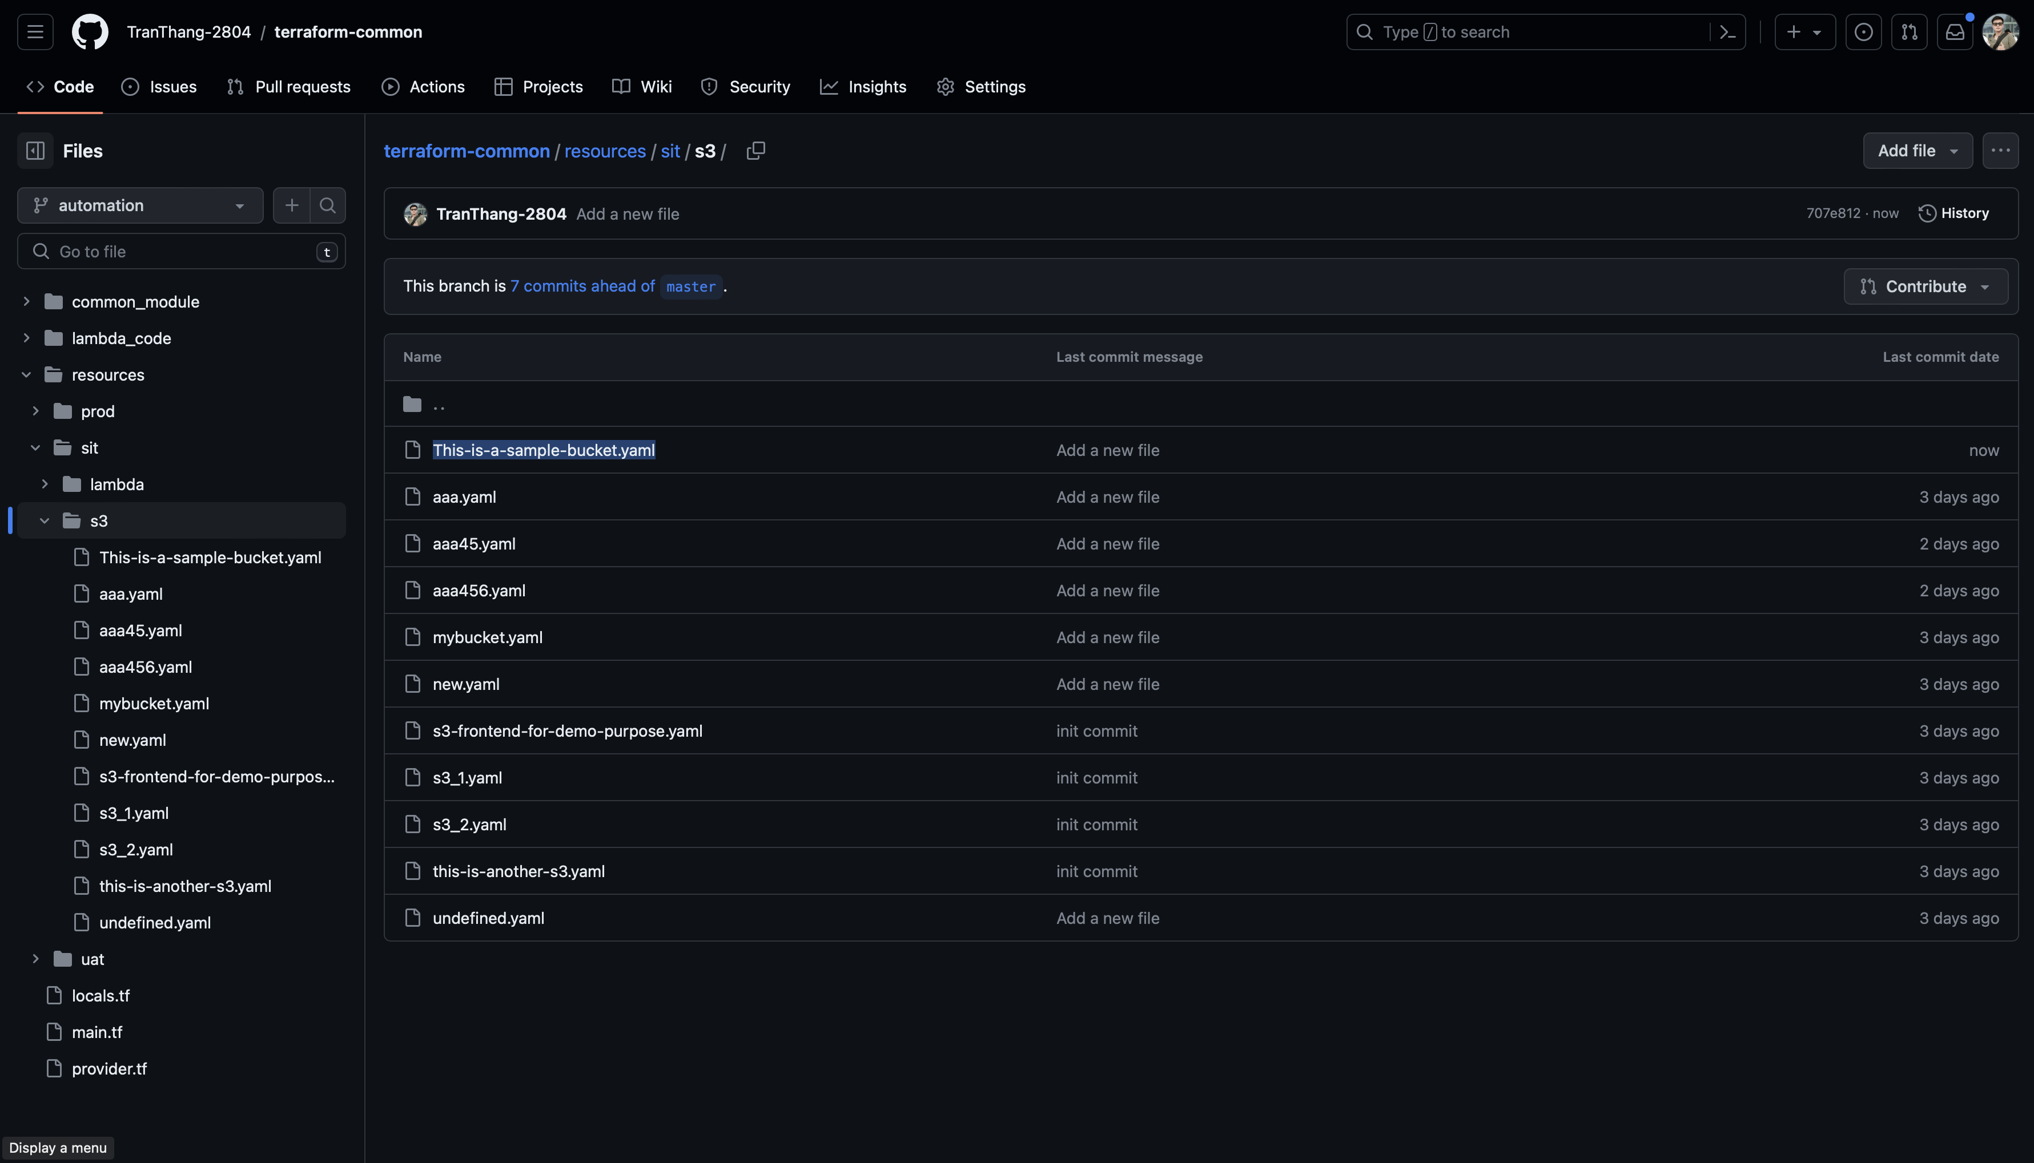
Backstage Infra Self-Service Plugin
Backstage infra self-service backend plugin create file a push to IaC repo
Each resource is a yaml file
Notes:
https://pixabay.com/es/photos/negocio-hombre-empresario-1042706/
https://pixabay.com/es/photos/modelo-empresario-corporativo-2911332/
https://pixabay.com/es/photos/gente-mujer-llamada-tienda-caf%c3%a9-2588594/
https://pixabay.com/es/photos/hombre-de-negocios-hombre-retrato-805769/
https://pixabay.com/es/photos/mujer-trabajo-oficina-pizarron-4702060/
https://pixabay.com/es/photos/empresario-hombre-corredor-de-bolsa-481113/
https://www.pexels.com/es-es/foto/hombre-de-chaqueta-de-traje-negro-con-ordenador-portatil-plateado-3777564/

Slide 19
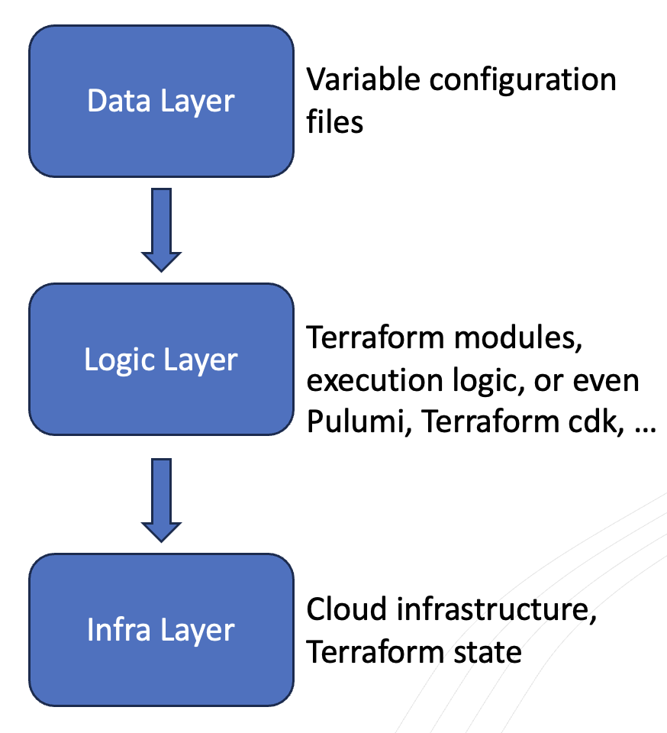
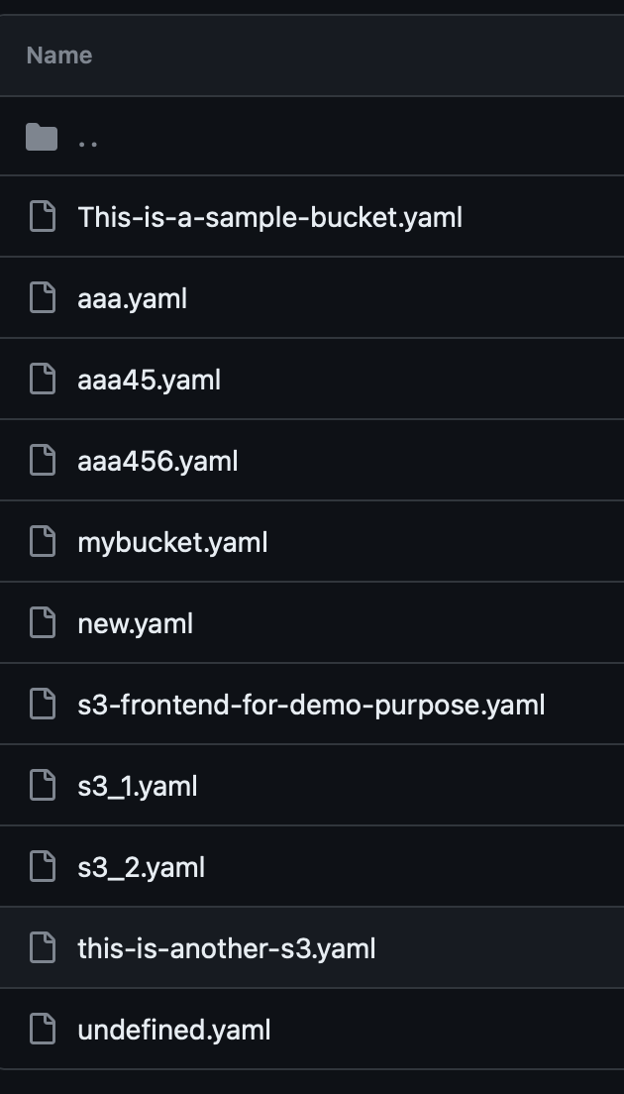
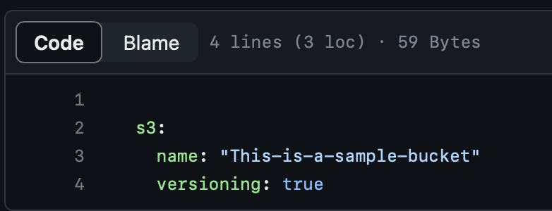
IaC management strategy
Iac file structure
Resource declareation
Notes:
https://pixabay.com/es/photos/negocio-hombre-empresario-1042706/
https://pixabay.com/es/photos/modelo-empresario-corporativo-2911332/
https://pixabay.com/es/photos/gente-mujer-llamada-tienda-caf%c3%a9-2588594/
https://pixabay.com/es/photos/hombre-de-negocios-hombre-retrato-805769/
https://pixabay.com/es/photos/mujer-trabajo-oficina-pizarron-4702060/
https://pixabay.com/es/photos/empresario-hombre-corredor-de-bolsa-481113/
https://www.pexels.com/es-es/foto/hombre-de-chaqueta-de-traje-negro-con-ordenador-portatil-plateado-3777564/

Slide 20
04
QA
Let’s have some discussion
Notes:
https://pixabay.com/es/photos/negocio-hombre-empresario-1042706/
https://pixabay.com/es/photos/modelo-empresario-corporativo-2911332/
https://pixabay.com/es/photos/gente-mujer-llamada-tienda-caf%c3%a9-2588594/
https://pixabay.com/es/photos/hombre-de-negocios-hombre-retrato-805769/
https://pixabay.com/es/photos/mujer-trabajo-oficina-pizarron-4702060/
https://pixabay.com/es/photos/empresario-hombre-corredor-de-bolsa-481113/
https://www.pexels.com/es-es/foto/hombre-de-chaqueta-de-traje-negro-con-ordenador-portatil-plateado-3777564/

Slide 21
THANK YOU
For hearing Tommy’s presentation
Notes:
https://pixabay.com/es/photos/negocio-hombre-empresario-1042706/
https://pixabay.com/es/photos/modelo-empresario-corporativo-2911332/
https://pixabay.com/es/photos/gente-mujer-llamada-tienda-caf%c3%a9-2588594/
https://pixabay.com/es/photos/hombre-de-negocios-hombre-retrato-805769/
https://pixabay.com/es/photos/mujer-trabajo-oficina-pizarron-4702060/
https://pixabay.com/es/photos/empresario-hombre-corredor-de-bolsa-481113/
https://www.pexels.com/es-es/foto/hombre-de-chaqueta-de-traje-negro-con-ordenador-portatil-plateado-3777564/

